Slide 1

The cell
Your body is made of trillions of cells. Are you ready to learn about cells?

Slide 2
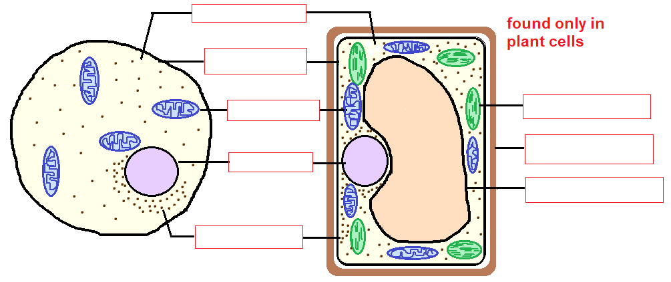
Structure of the cell

Slide 3
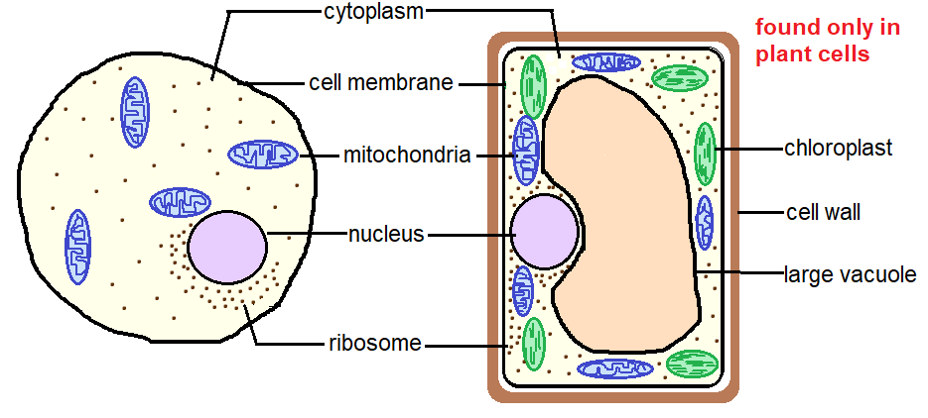
Structure of the cell
The sub-cellular structures found within a cell are known as ORGANELLES.
e.g. nucleus, chloroplast, mitochondria, ribosome

Slide 4
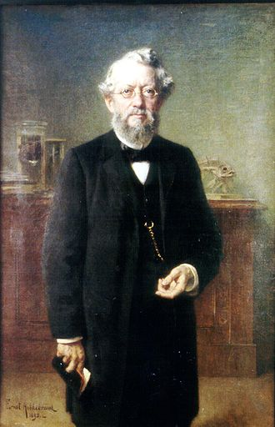
What is an organelle?
An organelle is a subunit within the cell that has a specific function.
Some organelles are enclosed by a membrane.
e.g. nucleus
mitochondrium
chloroplast
vacuole
Some organelles are NOT surrounded by a membrane.
e.g. ribosome
German zoologist
Karl August Möbius (1884) is credited to use this term first. He used it as organula

Slide 5
Functions of the different organelles of the cell
Organelle | Function
Cell membrane | Let the particles to selectively move in and out of the cell
Cytoplasm | Many chemical reactions occur
Nucleus | Controls all the cell activities
Mitochondria | Reactions of aerobic respiration take place and energy is released.
Ribosome | Protein synthesis
Cell wall | Gives support and protection to the cell; Movement of substances in and out of the cell
Chloroplast | Photosynthesis
Vacuole | Storage of substances; gives rigidity to plants

Slide 6

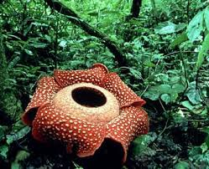
Animal cells vs. plant cells
Structures common to both animal and plant cells:
cell membrane
cytoplasm
nucleus
mitochondria
ribosomes
Structures found ONLY in plant cells:
cell wall
chloroplasts
vacuole

